Slide 1
Transformers Sequence Modeling
Understanding Machine Learning

Slide 2
Natural Language Processing (NLP)
dealing with sequential structures (e.g., text)
examples: sentiment classification, chat bot
recap:
neural language models: e.g., next-word prediction
using word embeddings as crucial building block (semantics)
RNN/LSTM for context awareness
next challenge:
sequence-to-sequence models: e.g., (neural) machine translation

Slide 3
Sequence-to-Sequence Models

Slide 4


Encoder-Decoder Architecture
end-to-end neural network approach (RNNs in encoder and decoder)
sequences $x$ and $y$ can have different length
context (fixed-length vector)
encoder-decoder bottleneck:
need to compress all information of source sentence into fixed-length vector
→ difficult for long sentences
auto-regressive
source

Slide 5




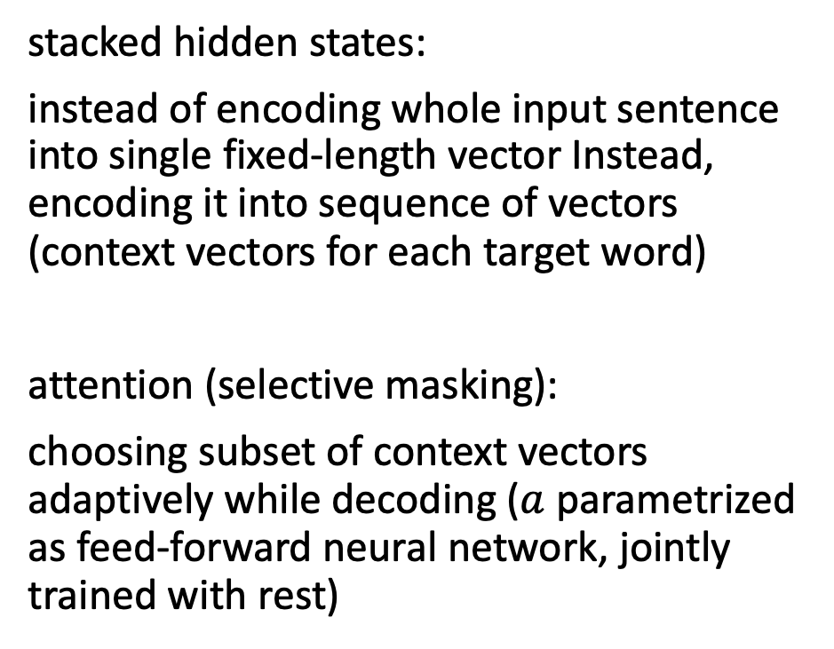
Attention to Overcome Bottleneck
stacked hidden states:
instead of encoding whole input sentence into single fixed-length vector Instead, encoding it into sequence of vectors (context vectors for each target word)
attention (selective masking):
choosing subset of context vectors adaptively while decoding ($a$ parametrized as feed-forward neural network, jointly trained with rest)
bidirectional RNN in encoder (concatenating forward and backward hidden states)
source

Slide 6
Self-Attention

Slide 7

Transformer
attention is all you need: getting rid of RNNs
replaced by multi-headed self-attention (implemented with matrix multiplications and feed-forward neural networks)
allowing for much more parallelization
→ allowing for bigger models (more parameters)
better long-range dependencies thanks to shorter path lengths in network (less sequential operations)
Let’s go through it step by step …
source

Slide 8

Tokenization and Embeddings
tokenization: breaking text in chunks
word tokens: different forms, spellings, etc → undefined and vast vocabulary (need for stemming, lemmatization)
character tokens: not enough semantic content (longer sequences)
→ byte-pair encoding as compromise for tokenization
one-hot encoding on tokens → token (word) embeddings:
only before bottom-most encoder/decoder
source
source

Slide 9
Byte-Pair Encoding
data compression method used for encoding text as sequence of tokens
merging token pairs (starting with characters) with maximum frequency
continue merging until defined fixed vocabulary size (hyperparameter) is reached
common words encoded as single token
rare words encoded as sequence of tokens (representing word parts)
alternative: direct operation on bytes (e.g., ByT5)
aaabdaaabac
ZabdZabac
Z=aa
ZYdZYac
Y=ab
Z=aa
XdXac
X=ZY
Y=ab
Z=aa
example from wikipedia

Slide 10

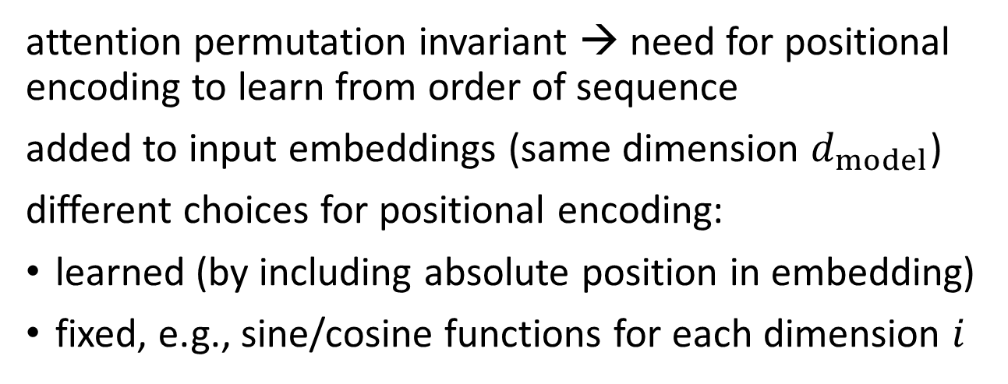
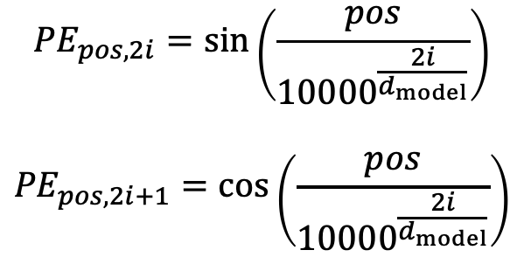
Positional Encoding
attention permutation invariant → need for positional encoding to learn from order of sequence
added to input embeddings (same dimension $d_{model}$)
different choices for positional encoding:
learned (by including absolute position in embedding)
fixed, e.g., sine/cosine functions for each dimension $i$
$${PE}_{pos,2i}=\sin\left(\frac{pos}{{10000}^{\frac{2i}{d_{model}}}}\right)$$
$${PE}_{pos,2i+1}=\cos\left(\frac{pos}{{10000}^{\frac{2i}{d_{model}}}}\right)$$
source
source

Slide 11


Encoder and Decoder Stacks
output of encoders/decoders fed as input to next ones
idea of depth:
providing redundancy
(even more important here than increasingly sophisticated abstraction, like, e.g., in CNN)
source
source

Slide 12

Skip Connections and Layer Normalization
skip connections and layer normalization for each sub-layer
skip connections improve robustness by preserving original input (attention layers as filters)
source
source

Slide 13

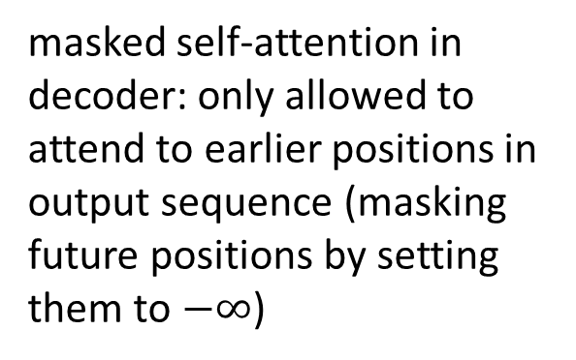
Self-Attention
evaluating other input words in terms of relevance for encoding of given word
computational complexity quadratic in length of input (each token attends to each other token)
masked self-attention in decoder: only allowed to attend to earlier positions in output sequence (masking future positions by setting them to $−∞$)
source
source

Slide 14


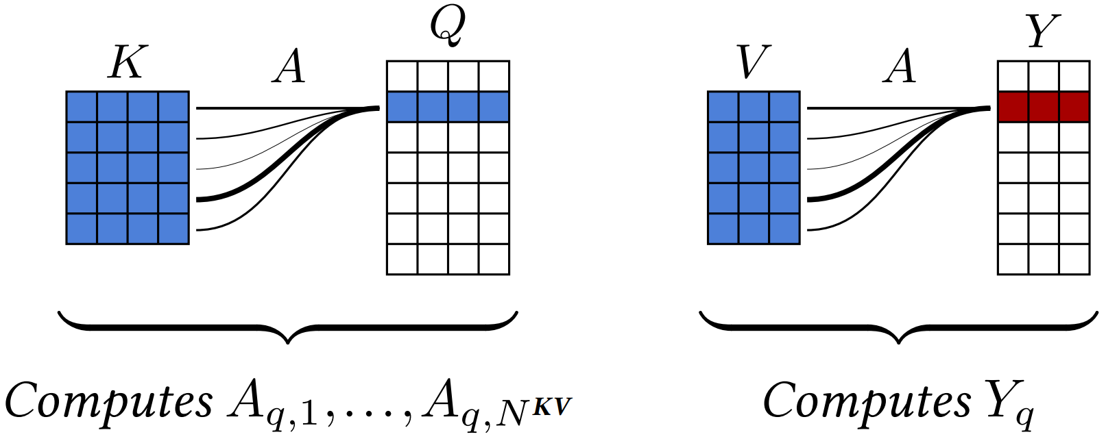

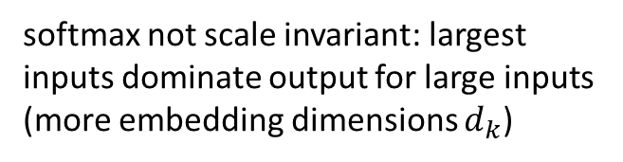
Scaled Dot-Product Attention
softmax not scale invariant: largest inputs dominate output for large inputs (more embedding dimensions $d_{k}$)
3 abstract matrices created from inputs (e.g., word embeddings) by multiplying inputs with 3 different weight matrices
query $Q$
key $K$
value $V$
filtering: multiplication of attention probabilities with corresponding key word values
scoring each of the key words (context) with respect to current query word: multiplication of inputs (in contrast to inputs times weights in neural networks)
key-value pairs
source
query
source

Slide 15


Multi-Head Attention
multiple heads: several attention layers running in parallel
different heads can pay attention to different aspects of input (multiple representation sub-spaces)
source
source

Slide 16

Involved Matrix Calculations
parameters to be learned
source

Slide 17

Position-Wise Feed-Forward Networks
for each encoder or decoder layer: identical feed-forward network independently applied to each position
attention is just weighted averaging → need for non-linearities (neural networks):
creating multi-word features from (self-)attention outputs (selectively masked words)
two network layers
source
source

Slide 18
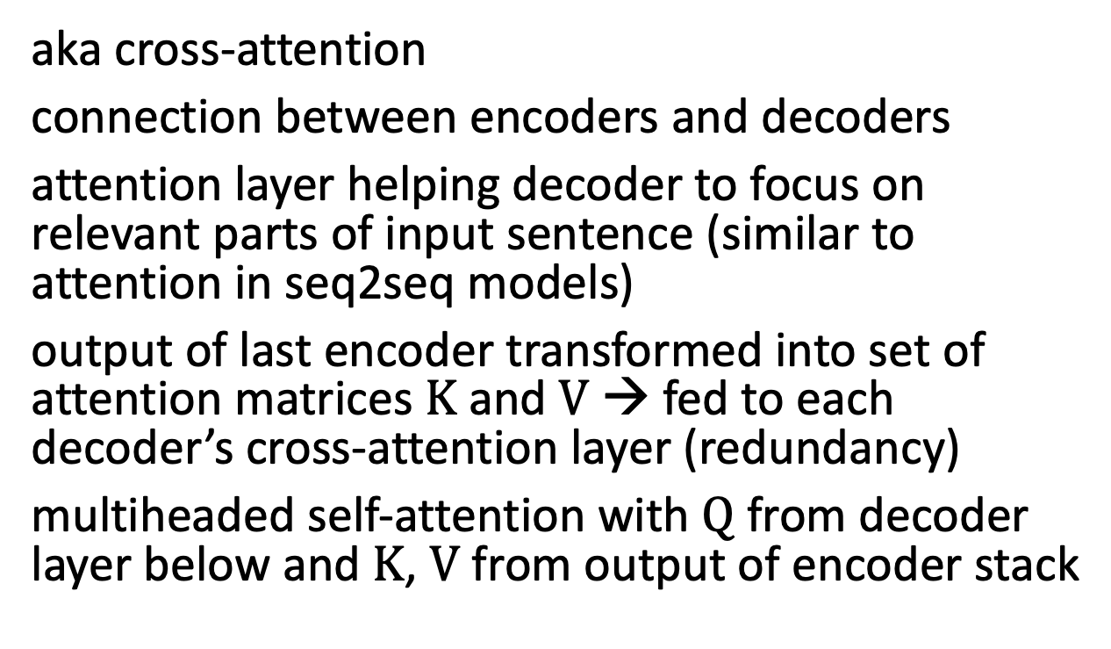
Encoder-Decoder Attention
aka cross-attention
connection between encoders and decoders
attention layer helping decoder to focus on relevant parts of input sentence (similar to attention in seq2seq models)
output of last encoder transformed into set of attention matrices $K$ and $V$ → fed to each decoder’s cross-attention layer (redundancy)
multiheaded self-attention with $Q$ from decoder layer below and $K$, $V$ from output of encoder stack
source

Slide 19

De-Embedding and Softmax
n: maximum sequence length
N: vocabulary size
d_model: embedding dimensions
conversion of final decoder output to predicted next-token probabilities for output vocabulary
de-embedding: linear transformation (matrix multiplication / fully connected neural network layer)
softmax: transformation to probabilities
(“softness” can be controlled by hyperparameter temperature)
source
source

Slide 20

Sequence Completion
greedily picking the one with highest probability
pick according to probabilities (degree of randomness controlled by softmax temperature)
beam search
for each step/token (iteratively), choose one output token to add to decoder input sequence → increasing uncertainty
prompt: externally given initial sequence for running start and context on which to build rest of sequence (prompt engineering)
auto-regressive
source
source

Slide 21
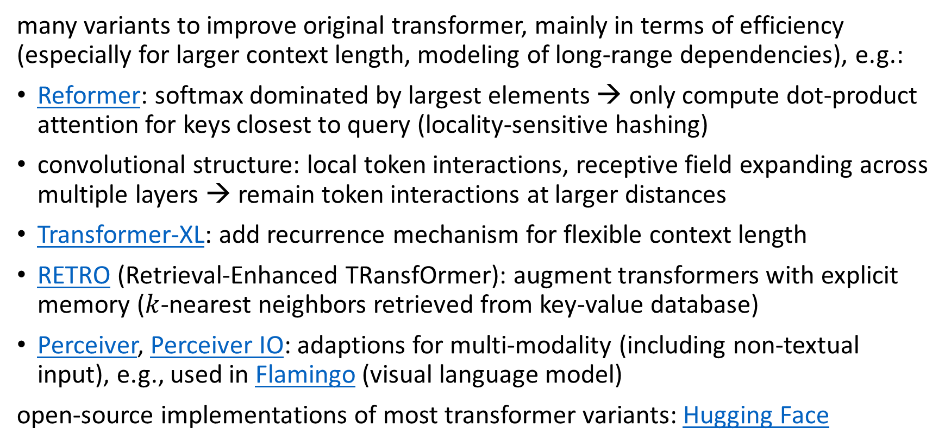
Transformer Variants
many variants to improve original transformer, mainly in terms of efficiency (especially for larger context length, modeling of long-range dependencies), e.g.:
Reformer: softmax dominated by largest elements → only compute dot-product attention for keys closest to query (locality-sensitive hashing)
convolutional structure: local token interactions, receptive field expanding across multiple layers → remain token interactions at larger distances
Transformer-XL: add recurrence mechanism for flexible context length
RETRO (Retrieval-Enhanced TRansfOrmer): augment transformers with explicit memory ($k$-nearest neighbors retrieved from key-value database)
Perceiver, Perceiver IO: adaptions for multi-modality (including non-textual input), e.g., used in Flamingo (visual language model)
open-source implementations of most transformer variants: Hugging Face

Slide 22
Large Language Models (LLM)

Slide 23


Slide 24

Typical Transformer Architectures for LLMs
encoder-decoder LLMs: sequence-to-sequence, e.g., machine translation
encoder-only LLMs:
representation learning (and subsequent fine-tuning)
training: prediction of masked words (via softmax after output embedding)
incorporate context of both sides of token
decoder-only LLMs:
text generation (potentially in-context only), e.g., chat bot
training: next-word prediction
output one token at a time (auto-regressive: consuming its own output)
example: BERT
example: GPT
source

Slide 25
Example for Encoder-Only LLM
BERT (Bidirectional Encoder Representations from Transformers, by Google, used in Google search engine):
stack of transformer encoders
outputting representation (embedding) to be used/fine-tuned in specific tasks and data sets (e.g., sentiment classification)
bidirectional: jointly conditioning on both left and right context
pre-trained in self-supervised manner on massive data sets
language modeling (masked tokens to be predicted from context)
next sentence prediction (predict probability of next sentence given first sentence)

Slide 26
Example for Decoder-Only LLM
another example: Meta’s Llama2
GPT (Generative Pre-trained Transformer, by OpenAI) series:
stack of transformer decoders → auto-regressive language model
generative pre-training: self-supervised generation of text (i.e., next-word predictions) on massive web scrape data sets
GPT-3: 175 billion parameters (Google’s PaLM: 540 billion parameters, …)
GPT: discriminative fine-tuning on specific tasks (e.g., summarization, translation, question-answering) with much smaller data sets
GPT-2, GPT-3: also zero- or few-shot learning (no parameter or architecture updates)
GPT-4: extend to multimodal model (image and text inputs, text outputs)
capabilities

Slide 27

Transfer Learning from Foundation Models
compositional nature of deep learning allows learning in a semi-supervised way (also prominent for CNNs in computer vision):
unsupervised (or rather self-supervised) pre-training on massive data sets (foundation models like GPT or BERT)
subsequent discriminative (supervised) fine-tuning on specific tasks and data sets (by adapting parameters or/and adding layers )
two other ways for improving general chat capabilities:
source

Slide 28
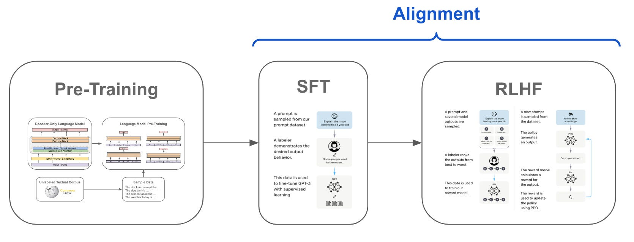
Instruction Tuning
source
supervised fine-tuning (SFT) for aligning (e.g., formatting) LLM output with human intention
one step further: reinforcement learning from human feedback (RLHF), e.g., in ChatGPT
(or without RLHF: DPO)

Slide 29
In-Context Learning: A New Paradigm
in-context learning as alternative to fine-tuning:
only using information fed into LLM via input prompt (typically decoder-only LLMs)
typical prompt:
instructions, context (potentially retrieved externally from, e.g., knowledge-base embeddings), query, output indicator
prompt engineering
GPT guide
increasing context length

Slide 30

Prompt Engineering with Examples
no fine-tuning:
text generation in response to priming with arbitrary input (adapting to style and content of conditioning text)
one (one-shot) or some (few-shot) examples provided at inference time: conditioning on these input-output examples (without optimizing any parameters)
zero-shot learning: no examples, just instructions → multi-task learning
possible explanation: locating latent concepts (high-level abstractions) learned from pre-training
GPT-3

Slide 31
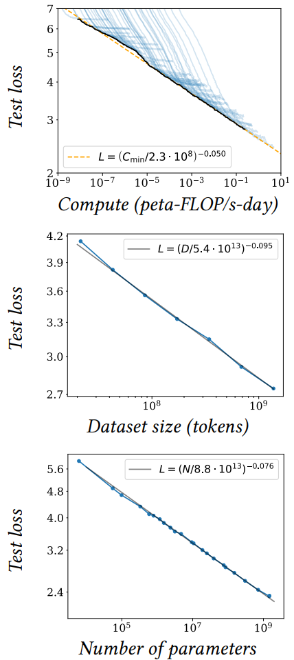
Size Matters: LARGE Language Models
scaling laws, Chinchilla: coupled performance power laws with model size, amount of training data, and compute used for training
→ era of large-scale models
emergent abilities of LLMs:
multi-task learning: perform new tasks at test time without task-specific training (simply via prompting)
reasoning capabilities (e.g., via chain-of-thought prompting, ReAct)
promise of a natural language UI for various applications (assistants), prominent examples: ChatGPT, Bard
source

Slide 32
Struggling with Facts
LLMs have only implicit knowledge (memorization of information in weights): limitations in terms of explicit factual knowledge, arithmetic operations, etc (hallucinating facts)
sometimes compared to Kahneman’s intuitive “System 1” (from Thinking, Fast and Slow)
analytical ”System 2” can be (partly) employed by:
retrieval augmentation, e.g., via vector stores (RAG, LlamaIndex)
tool usage (LangChain, Toolformer)
implicit code execution (e.g., in Bard)
still largely missing for AGI: agency (although simple automated workflows can be built)

Slide 33
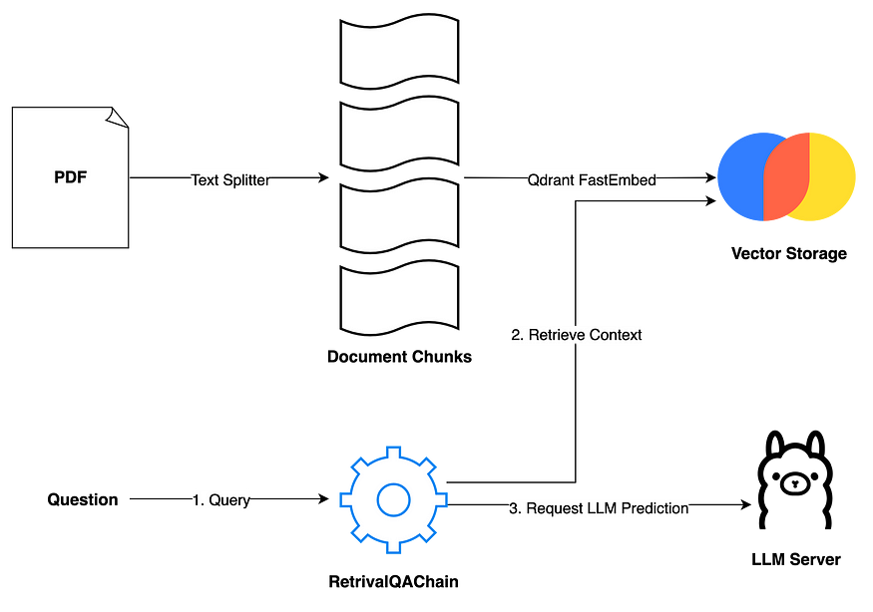
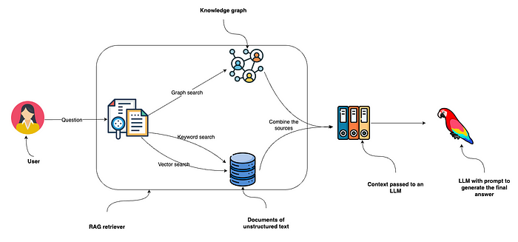
Retrieval Augmented Generation (RAG)
Examples:
source
source

Slide 34
Application
LLMs are “just” interfaces/translators: transforming one sequence (tokenizable input) into another
discriminative models
generative models
effective for performing numerical and optimization tasks (predictions)
continue to account for majority of AI value in wide range of industries (e.g., supply chain)
not suitable for classical use cases like numerical and optimization tasks
(But LLM agents might use prediction or optimization models as tools.)
but complimentary: drive value across entire organizations by revolutionizing internal knowledge management systems
(natural user interface)

Slide 35
LLMs in Plain Terms
foundation models:
compression of the internet
programming languages of new wave of AI applications (adapted to specific use cases and data)
→ These applications will make the internet more interactive.

Slide 36

What You Get Is What You Asked For
nice demonstration of capabilities of LLMs and prompting: interview with Google’s LaMDA
LaMDA (Language Models for Dialog Applications):
system for generating chat bots (conversational AI)
trained on dialogue data
decoder-only LLM
not sentient, but impressively capable in learning language: leading questions to suggestible statistical language model
source

Slide 37

Hot LLM Research Topics
transformer efficiency
(sparse) mixture of experts (e.g., Mixtral 8x7B, Gemini 1.5)
sparse attention (e.g., Longformer)
or non-transformer architectures (e.g., Mamba)
prompting strategies
let LLM agents show reasoning/planning capabilities
use tools (also embodiment/grounding)
prompt optimization (e.g., OPRO)
fine-tuning efficiency (e.g., LoRA)
RAG
make use of your own data

Slide 38
Transformers for Vision

Slide 39

Image Classification with Vision Transformer (ViT)
formulation as sequential problem:
split image into patches and flatten → use as tokens
produce linear embeddings and add positional embeddings
processing by transformer encoder:
pre-train with image labels
fine-tune on specific data set
source

Slide 40



Attention vs Convolution
global attention in lower layers (unlike local receptive fields in CNNs)
fewer inductive biases in ViT than in CNN:
no translation invariance
no locally restricted receptive field
Since these are natural for vision tasks, ViTs (conceptionally) learn them from scratch. → ViTs need way more data.
but can lead to beneficial effects (e.g., global attention in lower layers)
see MLP-Mixer results: given enough data, plain multi-layer perceptrons can learn crucial inductive biases
trainable position embedding:
source
added due to permuation invariance of attention

Slide 41

Combination of Vision and Text: Multi-Modality
world model
example: CLIP (Contrastive Language-Image Pre-training)
learn image representations by predicting which caption goes with which image (pre-training)
zero-shot transfer (e.g., for object recognition)
transformer
ViT
(or ResNet)
cosine similarity
joint embedding
multi-modal perception as input for LLMs: KOSMOS-1

Slide 42


Image Understanding and Multi-Purpose Models
multi-purpose (multi-modal and multi-task) models as next generalization step of ML (e.g., Google’s Pathways)
transformers good candidate: universal and flexible architecture, little task-specific inductive bias (but therefore needing lots of data)
source

Slide 43

Google’s Gemini:
multimodal understanding of inputs: text, audio, images, video

Slide 44
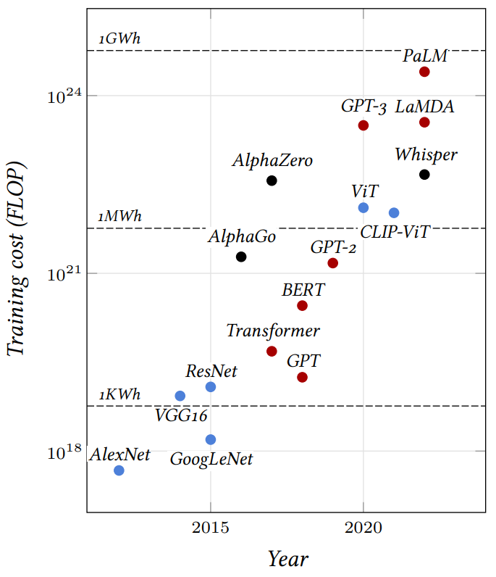
source

Slide 45

Preview: Image Synthesis
example: generate images from text descriptions
DALL-E, DALL-E 2, DALL-E 3 (blend of WALL-E and Salvador Dalí):
image generation (diffusion) conditioned on CLIP embeddings
source

Slide 46
Literature
papers:
seq2seq
neural machine translation
transformer
formal transformers
Vision Transformer
blogs/videos:
visualization of neural machine translation
The Illustrated Transformer
transformers summary
The Annotated Transformer
analysis of LaMDA interview

Slide 47

Low-Code/No-Code Programming
code generation in response to natural language prompt
Codex:
descendant of GPT-3
fine-tuned on publicly available code from GitHub
productionized as GitHub Copilot

